Slide 1
Othering, discrimination, and Racism
A mini-workshop

Slide 2
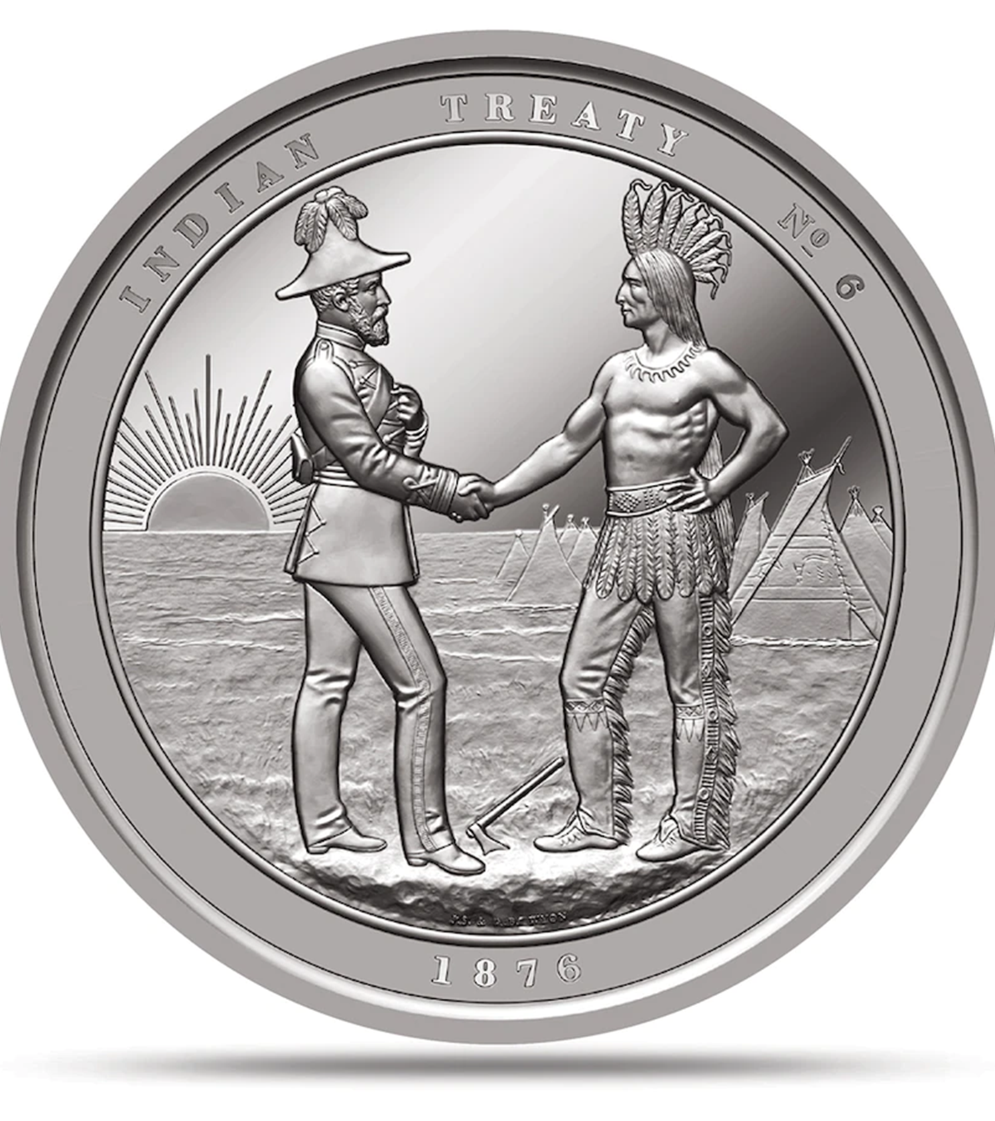
Land Acknowledgement
As we gather today, we would like to acknowledge the land upon which we work.
SIA is located upon Treaty 6 territory, homelands of the Nehiyawak, Nahkawe, Dakota, Lakota, Nakoda, Dene, and Métis.
As we do our work today, we aim to develop deeper understandings of ourselves, our relationships to one another, and our complex connections the history of this land.
We recognize that we are all treaty people, and that we must reflect daily to pursue growth and act in the Spirit of Reconciliation.

Slide 3
Treaty is not a “thing”
“Treaty marks an on-going relationship with, and including expectations and obligations from, the Crown and the original newcomers. It is not the piece of paper that was signed at the time but that the parties did smoke the pipe that lends this treaty its force of weight and thus is relationally sacred” (Kovach, 2013, p. 110-111).
“both Indigenous peoples and settlers in Canada inherit the treaty relationship with many difficulties and tensions but also possibilities rooted in respectful dialogue” (p. 115).
Margaret Kovach (2013) Treaties, Truths and Transgressive Pedagogies: Re-Imagining Indigenous Presence in the Classroom

Slide 4
Ice Breaker
Please share your name, pronouns, and 1-2 of the following:
Your favourite food memory
Something you are interested in discussing today
A quick fact about you ☺

Slide 5
What is “othering”?
What does it look like?
How does it feel?
Why do we do it?
What can we do to counter it?

Slide 6
Consequences of othering
Individual Level:
Can contribute to the formation of prejudices against people and groups, and objectifying of other people can lead to inhumane treatment becoming normalized or acceptable
Larger Scale:
Othering can lead to dehumanization of groups of people, which can lead to exploitation and greater harms such as genocide
Inequality:
Othering perpetuates a hierarchy between groups of peoples, resulting in differential treatment and gaps in access to certain social benefits
Under-recognition
While certain expressions of othering such as racism or ethnocentrism are well recognized, the broader impacts of othering are widely understudied.
Object to Subject: Three scholars on race, othering, and bearing witness. https://www.otheringandbelonging.org/object-subject-three-scholars-race-othering-bearing-witness/

Slide 7
How do biases feed into othering?
Social constructs inform our biases during our socialization as children.
Bias is when someone has an idea about how something “should” work, or a preference for some option over another.
Biases are natural. We all have them. They often persist in adulthood because of heuristics.
Biases are transmitted and learned consciously and unconsciously.

Slide 8
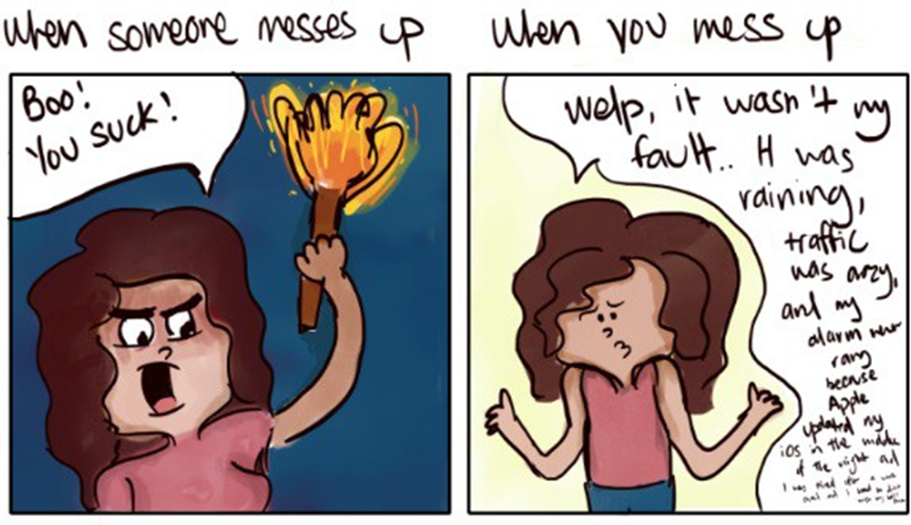
Affinity bias: the tendency to favor people who are similar to us by any identity-based aspect.
Attribution bias: How and why we assign blame to personal attributes.

Slide 9
Discrimination
Resulting Actions
Stereotypes
Cognitive Generalizations
Prejudice
Attitudes & Emotions
Stereotypes
“all in the group are the same” or one idea applies to everyone
Prejudice
emotional response such as fear, anger, disgust, anxiety, distrust.
Discrimination
refusal to accommodate disability, racially or culturally based hiring practices, redlining, exclusion, harassment, unfair treatment such as lower pay or selectively inaccessible promotions

Slide 10
Bias - A favoring on of one group over another based on assumptions.
Prejudice - A negative, often emotional prejudgment about a person based on a group generalization (stereotype) that denies individual members of certain groups to be recognized as individuals.
Discrimination - The inequitable treatment of members of various groups based on race, gender, social class, sexual orientation, physical ability, religion and other categories.
Racism - Different from racial prejudice, hatred, or discrimination. Racism involves one group having the power to carry out systematic discrimination through the institutional policies and practices of the society and by shaping the cultural beliefs and values that support those racist policies and practices.

Slide 11
Defining Racism
“The systemic subordination of members of targeted racial groups who have relatively little social power …
by the members of the agent racial group who have relatively more social power...
This subordination is supported by the actions of individuals, cultural norms and values, and the institutional structures and practices of society.” (p. 88-89)​
Source: Wijeysinghe, C. L., Griffin, P, and Love, B. (1997). Racism Curriculum Design. In M. Adams, L. A. Bell, & P. Griffin (Eds.), Teaching for diversity and social justice: A sourcebook (pp. 82-109). New York: Routledge.

Slide 12
Levels of Racism in our Society
Multicultural council of Saskatchewan. (n.d.). Anti-racism resources. https://mcos.ca/programs/anti-racism/resources/

Slide 13
How might racism manifest in the workplace?
Systemic / Institutional Racism
Interpersonal
Microaggressions
Indirect Racism (lacking DEI)
Company’s visual space (atmosphere, titles of places, representation)
Othering, non-inclusive practices (e.g., leaving some people out of meetings or gatherings)
Organizational practices: exclusionary network hiring (racial, cultural, faith-based), promotions/raises for friends or favoured persons, not based on merit/experience
Assumed equality of treatment in policy: (all workers must work on Saturdays, the Jewish Sabbath, or all workers receive Christmas holidays only)
Use of derogatory terms, referencing stereotypes

Slide 14
How to deal with racism in the workplace
Pause/Stay Calm - Prioritize Your Safety and Security. Internally name it.
Consider Potential Risks (social, physical, emotional etc.) in Confronting and NOT Confronting the Racism.
Take Care – Receive and Give Community/Family/Mental Health Support.
Identify your Allies/Safe People, call on them for support in the moment.
Document all Incidents! Name the Impact.
Change the Subject / Walk Away.
Report it to your Manager or HR -assuming they are a Safe Person/Organization. In Serious Cases, you can file a police report or a complain to the Human Rights Commission.
Given That you have Considered the Risks - Call it Out or Call Them In.
It’s OK to call out racism without feeling obliged to change the other person's views. Sometimes, simply saying, "That's an offensive comment“ can shut down the interaction.
Sometimes asking them to rethink their words or actions by asking “what do you mean?” or “can you explain that, I don’t understand why it’s funny” might be the best course of action.

Slide 15
Addressing Racism on an Organizational Level
Creating policies that affirm anti-racism.
Have approachable leaders.
Creating a safe space for discussion, trust, care.
Educating the workforce.
Acting on DEI principles.
Procedures for hiring, onboarding, reporting, consequences for offensive behaviours
Offering trainings on expectations, mandates, goals.
Ensuring workforce is representative, treatment is equitable, everyone feels included and valued.

Slide 16
Thank you!
Resources referred to in this presentation:
Margaret Kovach (2013) Treaties, Truths and Transgressive Pedagogies: Re-Imagining Indigenous Presence in the Classroom
Wijeysinghe, C. L., Griffin, P, and Love, B. (1997). Racism Curriculum Design. In M. Adams, L. A. Bell, & P. Griffin (Eds.), Teaching for diversity and social justice: A sourcebook (pp. 82-109). New York: Routledge.
Multicultural council of Saskatchewan. (n.d.). Anti-racism resources. https://mcos.ca/programs/anti-racism/resources/
Object to Subject: Three scholars on race, othering, and bearing witness. https://www.otheringandbelonging.org/object-subject-three-scholars-race-othering-bearing-witness/
Kendi, Ibram. (2019). How to be an Antiracist. One World Pub.

