Slide 1
2017
How we hosted a mini comic con at the library
Meghan O’Leary, MLIS
Collections and Readers Advisory Librarian
John M. Cuelenaere Public Library

Slide 2
Some important Questions
Do you know what a comic con is?
Have you ever been to a comic con or similar pop culture event?

Slide 3
Presentation Outline
Introduction to Geek Culture
Why host a Comic Con?
How we did it
Results
What we would do differently next time

Slide 4
A brief introduction to the world of Geek Culture
For the uninitiated

Slide 5
What is a Comic Con?
Short for “comic book convention”
An event where the primary focus is on comic books, graphic novels and other pop culture fandoms
Comic cons host various events such as panels, movie screenings, guest Q&A sessions, cosplay contests, etc.
Comic cons are a derivative of science fiction conventions which started in the 1930s
San Diego Comic Con is one of the most well known comic cons and is one of the largest pop culture festivals in the world
It was founded in 1970 as the Golden State Comic Book Convention
Notes:
Comic con is short for comic book convention.
These are events that are primarily focused on comic books, anime, manga, television, and other forms of pop culture.
Usually Comic con organizers will bring it famous guests, host panels, have movie or anime screenings, and host cosplay contests.
A lot of people attend comic cons or similar events because they enjoy cosplaying, and meeting new people with similar interests.
The origin story of the comic cons is based on the science fiction conventions that began in the 1930s. The first science fiction convention was held in 1939 in New York.
San Diego Comic Con which was founded in 1970 is one of the largest comic cons in the world and is used as a standard for other comic cons.
A lot of people dream about going to this event but because it has gotten so big in order to get tickets to the event you need to enter a lottery and hope the odds are ever in your favour.

Slide 6
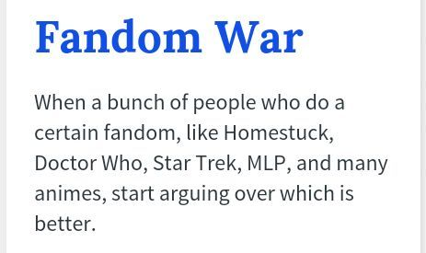
What is fandom?
The word ‘fan’ is a shortened form of ‘fanatic’
A fandom is a subculture composed of fans characterized by a feeling of empathy and camaraderie with others who share a common interest
Anything can have a fandom:
anime, television, movies, comics, sports, musical artists, novels, etc.
Fandoms can be combined by fans
Example: SuperWhoLock
Notes:
The word “Fan” is the shortened form of the word “fanatic” and a fandom is a subculture of fans who share the same interests.
Usually members of a fandom will congregate online to talk about things like, what should happen next in the series, or which characters should be in a relationship, etc. etc.
Think of fandom like a kingdom where the monarch is the item of interest and the royal subjects are the fans.
Anything can have a fandom and sometimes fandoms are combined to form new fandoms – for example: SuperWhoLock is a combination of the fandoms of Supernatural, Doctor Who, and Sherlock
A “fandom war” is when people from different fandoms start arguing about who has the best fandom.
Sometimes the fans in certain fandoms give themselves labels.
For example, fans of the podcast Critical Role call themselves Critters and fans of doctor Who Are called Whovians

Slide 7
What is cosplay?
A combination of the words ‘costume’ and ‘play’
A performance art in which participants called cosplayers wear costumes and fashion accessories to represent a specific character
Notes:
Cosplay is very popular at comic cons. The majority of people who attend conventions wear some kind of cosplay or character inspired outfit
Cosplay is the combination of the words Costume and Play and based off the Wikipedia entry for cosplay it is a form of performance art.
Cosplayers make and wear costumes that represent characters from various forms of pop culture.
The cosplay community is huge and there are many Facebook groups dedicated to sharing knowledge, techniques. and pictures.
Some people have become so popular that they have become professional cosplayers who attend and compete in contests around the world.
A few years ago a television series called Heroes of Cosplay aired on the SyFy channel and it was a documentary type show that followed a few different professional cosplayers while they created their costumes and competed in various contest around the united States and Canada.
The photos on this slide and the next are from the Queen City Cosplayers facebook page.

Slide 8
What is Cosplay?
The term "cosplay" was coined in Japan in 1984.
Cosplay was inspired by the practice of fan costuming at science fiction conventions
Myrtle R. Douglas is considered the mother of cosplay because of the costumes she created for the 1st World Science Fiction Convention in New York City in 1939.
Notes:
The actual term “cosplay” wasn’t coined until 1984 in Japan,
But cosplay began in the 1930s when fans of science fiction novels and films would dress up for science fiction conventions.
The person who is considered to be the “mother of cosplay” is Myrtle R Douglas.
She was the first person to create costumes based on characters from a science fiction film.
She and her boyfriend wore those costumes at the 1st Science Fiction Convention in 1939 in New York City.

Slide 9
Myrtle R. Douglas and Forrest J. Ackerman at the 1st World Science Fiction Convention in New York City in 1939.
The costumes were based on the pulp magazine artwork of Frank R. Paul and the 1936 film Things to Come
Notes:
Here is a picture of Myrtle and her boyfriend Forrest J. Ackerman in their costumes at the 1st Science Fiction Convention.
The costumes were based off the artwork by Frank R Paul for the 1936 film “Things to Come”

Slide 10
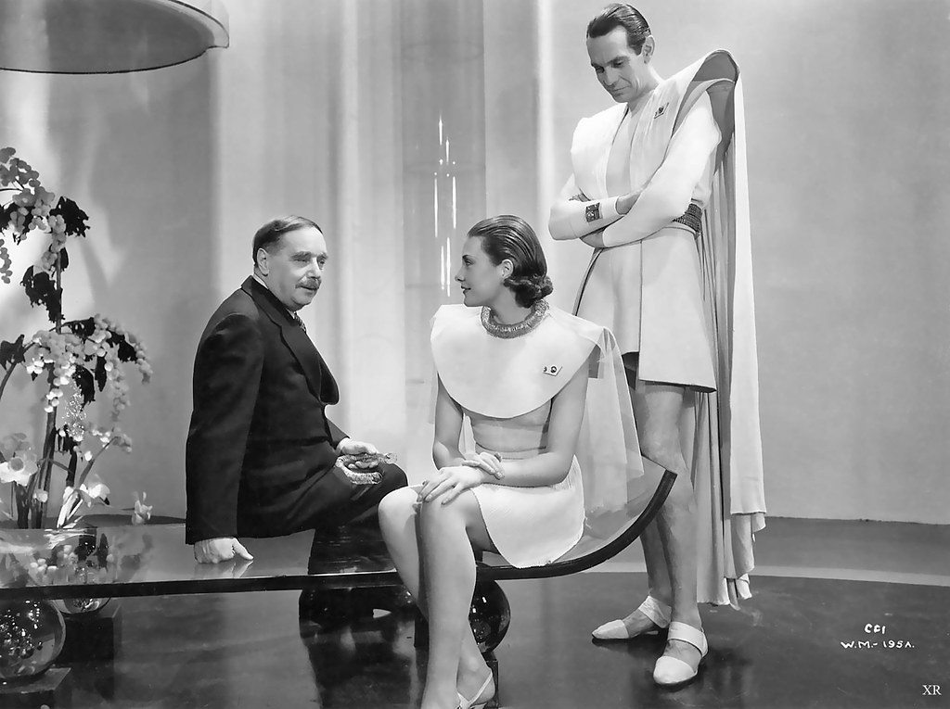
Scene from Things to Come (1936)
Notes:
Just for reference, here is scene from the film so you can see what Myrtle and Forrest were supposed to be dressed like.

Slide 11
Why did we decided to host a comic con?
It’s chic to be geek!

Slide 12
Different Audiences
Comic cons are trendy and we wanted to show that the library isn’t just books anymore
Reach out to families who are looking for something fun and different to do with the kids
Adults who have been into geek culture their whole lives but didn’t know about what we have to offer at the library

Slide 13
Different Audiences
Reach out to children or teens who feel isolated because of their geeky interests – comic con lets them meet new friends
Notes:
Having been a geeky kid myself I know how hard it can be to like something but not have anyone to share it with.
We wanted to reach out to kids and teens who might feel isolated because they like geeky things.
Hosting a comic con give those kids a place where they can connect to other kids with similar interests.

Slide 14
Reader’s Advisory
We wanted to highlight different areas of our collection so that the usage goes up:
Graphic novels
Video games
Manga
Anime
Notes:
Wanted to make Bibliocon about the collection as well.
It wasn’t solely about upping out circulation stats
It was also about showing people that we have these collections and giving them new ways to consume the media they already enjoy.
From a reader’s advisory point of view:
Wanted to highlight some of our collections that are sometimes overlooked such as
our vast graphic novel and manga collections. Manga is Japanese comic books, for anyone who might not be aware. It is hugely popular.
We have comic books and manga for juvenile, young adults, and adults at our library.
Also wanted to show off our relatively new video game collection
The amount of people who come in and say “Wow the library has video games?!” is cute. They get so excited.
We also have a lot of anime dvds and blurays, as well as Marvel and DC super hero movies.

Slide 15
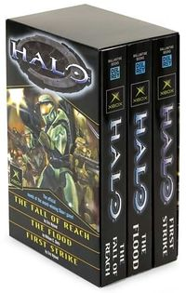
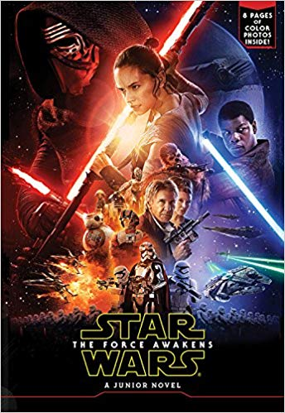
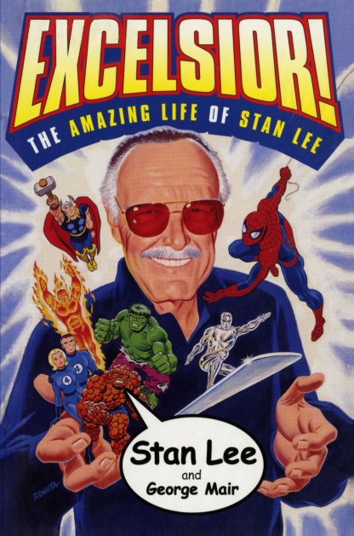
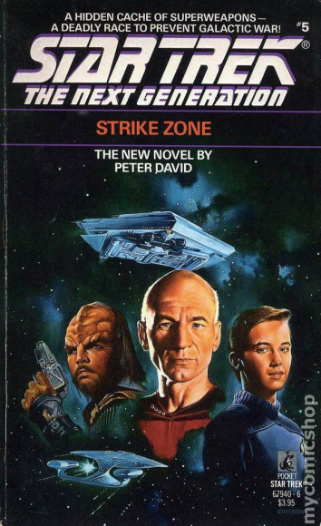
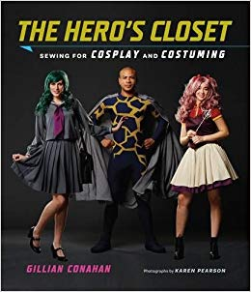
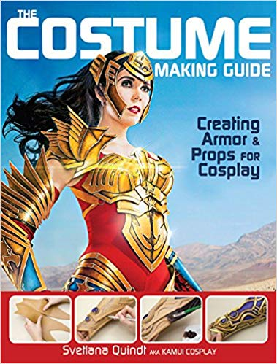
Reader’s Advisory
Fiction and non-fiction based on geek culture
Notes:
Wanted to highlight our regular fiction and non-fiction books that are based on geek culture
For example, there are novels based on the popular Halo video games, and there are novels about Star Trek and Star Wars, just to name a couple.
There are also biographies of famous actors who are popular in geek culture media.
One example is Felicia Day’s autobiography “Everyone is Weird on the Internet (Almost)’
Or Stan Lee’s autobiography “Excelsior!: The Amazing Life of Stan Lee”
Also there are books about how to create and build cosplays

Slide 16
Statistics
Wanted to increase different types of statistics we gather
Gate count and foot traffic
People needed to go upstairs for their program and goodie bag
Circulation of highlighted collections
Had a display of geeky materials for loan
Patron registration for library cards
Encouraged patrons to get a library card in order to get their free Bibliocon mini button
Notes:
We wanted to see if hosting a comic con would boost any of our regular daily statistics such as
Our foot traffic gate counts
To encourage more foot traffic we asked people to go upstairs to register for the event.
The circulation of highlighted collections
I created some displays of the highlighted materials out in the common area by the circ desk.
And patron registrations.
We encouraged people to show their library card in order to get free mini Bibliocon button.

Slide 17
How did we do it?
Planning, Planning, Planning

Slide 18
Deciding on a budget
Ask yourself how much you want to spend on a comic con, and how much can you spend on a comic con?
We wanted to do Bibliocon on a $0 budget because:
Free program is easier to pitch to the higher-ups
We didn’t want to charge admission from patrons
First time doing something of this kind, so we didn’t want to invest too much money into it in case it was not successful
It is possible to host a comic con at the library without spending much or any money at all!
Notes:
The first thing you’ll want to do it decide on a budget.
Ask yourself how much you want to spend on hosting a comic con and how much you realistically CAN spend.
We decided to host Bibliocon on a virtually zero dollar budget. I say virtually zero dollars because we didn’t calculate in the costs of materials we already had on hand such as paper and printing, and the button making supplies we had in storage.
The reason we wanted to do it for zero dollars is because we thought it would be easier to pitch the idea to our higher-ups if there was no money involved.
We also didn’t want to have to charge admission, which a lot of larger comic cons do.
And, it was our first time attempting to organize and host an event like this so we didn’t want to sink too much into it in case it flopped.

Slide 19
How we had a $0 budget
We used our own space – no rental fees
We did our own graphic design
We created our own promotional items such as buttons, programs, and posters
We were upfront with guests that we couldn’t pay them and they were understanding
We asked local businesses to donate prizes for the event

Slide 20
Picking a day
“Con Season” is the time of year when most conventions occur – April to September
Check the dates of local pop culture conventions so you don’t overlap
Pick a time when there are not too many conflicting events
We chose to host Bibliocon on June 3rd because there were no other pop culture conventions being held in June
However, we had to work around high school graduations, a street festival, and other local events.
Look at your own programs schedule
Pick a day where you have nothing planned
Plan early enough that you can work around your comic con date
Notes:
After determining your budget (zero dollars or otherwise) you will want to establish a date for your event.
The Con Season is the time of year when most conventions are happening.
We wanted to make sure we didn’t overlap with any other conventions happening around the prairies so we chose to host Bibiocon on Saturday June 3rd.
While we didn’t overlap with any other conventions we still had to deal with high school graduations, our local street fair, and other events happening around the city.
We also had to make sure we had no conflicting programs scheduled at the library during that time and that the date we chose corresponded with the work schedules of the people organizing.

Slide 21
Local conventions on the Prairies
Some of the major conventions:
Calgary Comic & Entertainment Expo, Calgary – Apr. 25-28, 2019
Sask Entertainment Expo, Regina – May 4-5, 2019
Otafest, Calgary – May 17-19, 2019
Keycon, Winnipeg – May 17-19, 2019
Ganbatte Con, Saskatoon–July 13-14, 2019
Ai-Kon, Winnipeg – July 26-28, 2019
Animethon, Edmonton –Aug. 9-11, 2019
Queen City AniFest, Regina – Aug. 24, 2019
Sask Entertainment Expo, Saskatoon –Sept. 14-15, 2019
Edmonton Comic & Entertainment Expo, Edmonton – Sept. 20-22, 2019
Notes:
This is a list of the major conventions happening throughout Alberta, Saskatchewan and Manitoba during the Con Season this year.
Most of the time conventions will be scheduled at the same time every year, but it’s always a good idea to double check before you book your event.
If you haven’t attended a comic con or similar event before I highly recommend attending one before hosting one at your library.
It will give you an idea of the format most conventions follow and what to expect when you host one of your own.

Slide 22
Asking for sponsors
Look at local businesses that are related to geek culture:
Book shops, game store, hobby shops, etc.
Send letters requesting prize donations. Most places are more willing to donate a physical item instead of funds. As incentive you can offer:
Their logo on the program and website
A table in the vendor area
Our sponsors included:
Microplay
Tramps
J&P Hobby Supplies
Fabricland
Giant Tiger
Notes:
Once you have picked the day for your event now you can start asking local businesses for sponsorships.
We drafted up a letter asking for prize donations for Bibliocon and dropped them off with local business owners.
We asked for prizes rather than monetary donations because we felt that businesses are more willing to donate an item rather than money in most cases.
We stated in the letter that if they were willing to donate a prize we would post their logo on our Bibliocon webpage and we would have them listed as sponsors on our event program.
If we had the space for it we would have offered them a table they could sell their merchandise at during the event.
We got lots of generous prize donations from five different businesses and we used them for door prizes, cosplay contest prizes and fan art prizes.

Slide 23
Planning out the space
We used the space we had instead of hosting offsite!
Story Corner:
geeky crafts for kids
Meeting rooms:
host concurrent fan panels
Auditorium:
show Studio Ghibli films
host the improv group
cosplay contest
The downstairs public space
displaying the fan art contest
vendor tables
local author guests could sell their books and do autographs
Notes:
We used our own library space rather than hosting the event off-site so we could avoid rental fees.
At our disposal we have two meeting rooms which we used for running guest and fan panels,
An auditorium for showing movies and hosting the improv team and cosplay contest,
a story and craft corner for the kids geeky craft time,
and some public space downstairs where we set up tables for our guests and vendors.
We also used a display case downstairs to display the fan art submitted for the fanart contest with a ballot box for people to vote for their favourite art

Slide 24
Planning the events
Guest presentations
Fan Panels hosted by fans in the community
Fan art contest
Cosplay contest
Studio Ghibli movie screenings
Geeky Improv Group
Geeky crafts
Notes:
We had guest and fan panels
A cosplay contest
A fan art contest
Studio Ghibli film screenings
Geeky kids crafts
And, Off the Cuff Improv did a geeky improv show for us. They do a similar show at the Sask Expo in Saskatoon every year.
To organize the timing of the events I started with an empty time table with a column for each room or area
Ask your panelists and guests if they have preferred times for their panels so you can accommodate to their needs.
Then fill in the main events like the cosplay contest.
Traditionally, the cosplay contest is at the end of the day so it encourages people to stay the whole day.
We also handed out prizes at the end of the day as to encourage people to stay. We told them when they entered for the door prizes that they needed to be at the prize ceremony to claim their prize.

Slide 25
Finding Guests
Check for local people
Search online – Ask local geeky Facebook Groups
Check local newspapers
I found one of my Bibliocon guests this way
Draw on your own resources:
I happen to know some local fantasy/sci-fi authors and I asked them to come
Look at the guest list of other local conventions and send them an email
Be upfront with that you can offer your guests
We offered a free table in the vendor area where they could sell their books
Offer to pay for their gas if they are from out of town
If you can’t offer any kind of monetary compensation just tell them. Most will be reasonable, and the worst they can say is no.
Ask early so people can make arrangements
Notes:
Finding guests for your convention can be tricky, and to be honest you don’t NEED to have guests. A lot of people enjoy going to conventions regardless of whether there are guests there.
But if you do want to have guests start by looking for local people.
Look for local authors, or cosplayers would probably be willing to be guests since they wouldn’t need to travel.
I happen to know a couple of local fantasy/sci-fi authors so I asked them if they would be willing to be guests.
I also found one of our guests by seeing an article in the newspaper about a local man who writes for the Teenage Mutant Ninja Turtles comic books.
You can always ask around on local geeky Facebook groups as well. Lots of people give you suggestions.
Another way to find people to be guests is to look at the guest lists of other local comic cons.
Be upfront with your guests about what you can offer them. If you can offer to pay for gas that’s great, but if not just tell them. They may still be happy to come be a guest even if they get nothing out of it except “exposure”
One last tidbit of advice regarding guests. Ask them early on if they are willing to be a guest so they can make arrangements. If you host your comic con outside of the Con Season it will be easier for them to schedule.

Slide 26
Finding Panelists
Ask your nerdy friends
Since it was our first year doing Bibliocon I “asked” my friends to do panels
If you don’t have a bunch of super talented nerdy friends to exploit:
Post online asking for panel submissions
Create a form and post the link.
Make sure you have guidelines – must be G rated, must be about comics/anime/geek culture, etc.
Check out the panel submission forms for other cons for ideas.
Ask your staff if they would like to do a panel
If you have an anime club at the library they may want to host a panel, or volunteer to help out in other ways
Notes:
Panels are the equivalent to sessions at a conference.
They range in topics from cosplay to various fandoms, to guest Q&As
Panels are what most people will be spending their time doing at a comic con.
I have a lot of very talented nerdy friends so I asked them if they would host panels for me at Bibliocon.
Asked is in quotations because I didn’t really ask… I voluntold. Thankfully they were all willing.
If you don’t have a bunch of talented nerdy friends to exploit you can always put a call out through social media asking for panel submissions.
This is what most conventions do.
They will have a form on their websites and ask people to submit their panel suggestions
You could also ask your colleagues if they would be willing to do a panel,
or if you have an anime club they may want to do a panel or volunteer in some other way.
Our anime club at JMCPL hosted a panel where they dressed up as characters from an anime, then had a Q&A where they answered questions in character.
We had a few new anime club members after Bibliocon which was pretty cool!

Slide 27
Graphic Design and marketing
Used PowerPoint and Photoshop to create our own logo, posters and programs
No Photoshop? No problem! Use pixlr.com
Used our own button maker to create mini buttons to give away to registered Bibliocon guests
Created Facebook event
Shared on various local geeky Facebook groups
Created subsection of our website for all the information
Notes:
I did all the graphic design for Bibliocon. I designed all the posters, the program, and the logo using Photoshop and Microsoft Publisher and Powerpoint
See the similarities in my power point presentation and my Bibliocon poster??
I chose to go with this theme because it matches the colours of our library logo
The Bibliocon logo was just a clipart of a book with a special font I downloaded from dafont.com
If you don’t have Photoshop you an use a free online version called pixlr.com
We didn’t want to spend any money on buying schwag to give away to attendees in case our attendance was low,\
So we made mini Bibliocon buttons using the button maker we got for our programs department. We spent a lot of time making them, so next time we need to decide if saving the time is worth spending a little bit of money getting buttons or other schwag made.
We did all our own marketing as well. We printed posters and put them up around town, especially at the businesses who donated prizes.
And we also created a Facebook event and shared it on various geeky facebook groups.
The Facebook groups I shared to mostly were:
Geeks of Prince Albert and Area
Rusty Owl Steampunk Society
City of Bridges Steampunk Society
Saskatoon and Area Cosplayers
Ganbatte Con Community Group
If anyone is interested in looking at the poster, program, or buttons I brought some examples you can check out at the end of the presentation.

Slide 28
Special Rules and Policies
Most cons have special policies regarding cosplays and cosplay props
On our Bibliocon page we included a link to the general library policies, as well as a Bibliocon specific Code of Conduct
Notes:
A lot of conventions have specific policies and codes of conduct regarding cosplay, consent, photography, etc.
Our regular library policies don’t take into considerations cosplays and cosplay props so I looked at a lot of different policies from other conventions and created Bibliocon policies based on them.
Having specific policies regarding cosplay and cosplay props is important because it allows you to ask someone to leave or change if you think their outfit is inappropriate or their prop is too dangerous.
Next time we host Bibliocon I will include a more specific photography policy that says something a long the lines of “by attending this event you are agreeing to have your picture taken by official JMCPL staff and shared on JMCPL web presence. If you want to opt out of this please talk to the Circulation staff so they can give you a no-photos badge. Your picture may still be taken and shared but we will blur out your face.”

Slide 29
The Results
And feedback

Slide 30
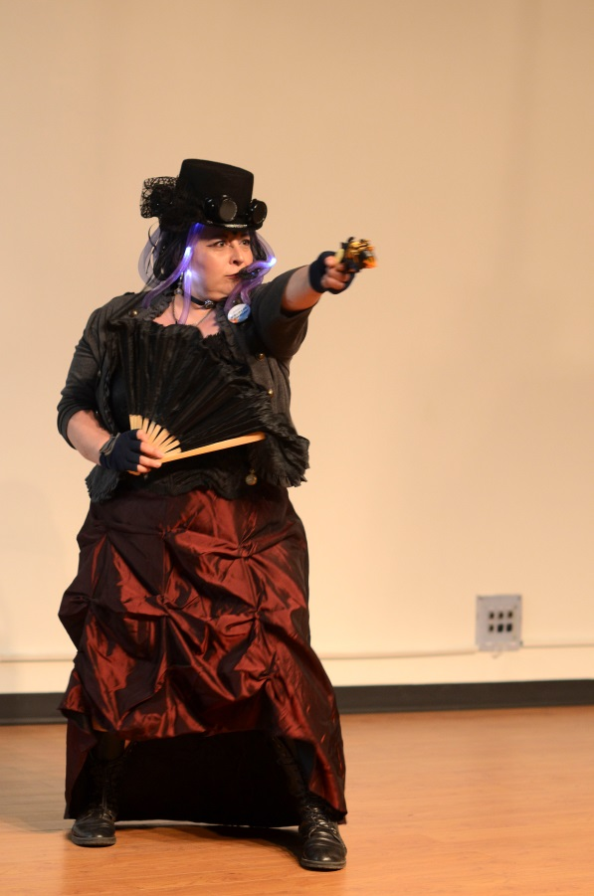
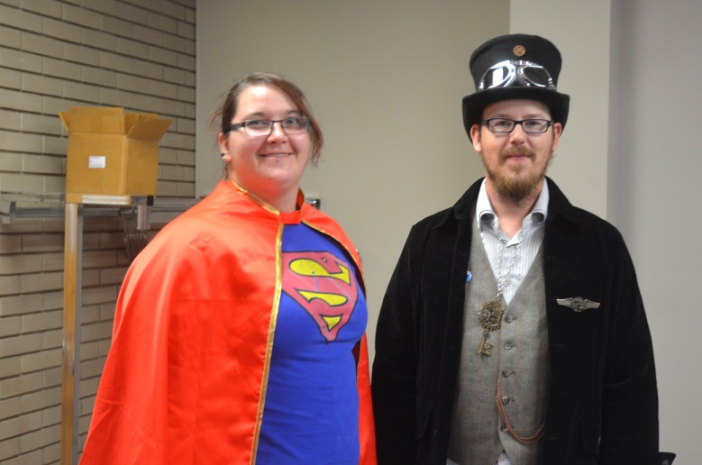
Pictures
Notes:
Before getting into the results I wanted to share some of the photos we got that day.
A reporter from the local newspaper came and wrote up an article about the event and most of these photos were actually taken by the that him. He graciously granted us permission to post them on our website.
On this slide I have a few pictures of some of the cosplayers who came to Bibliocon

Slide 31
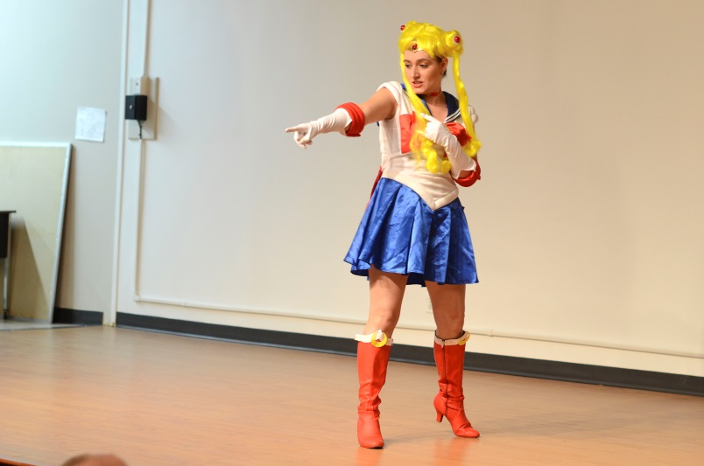
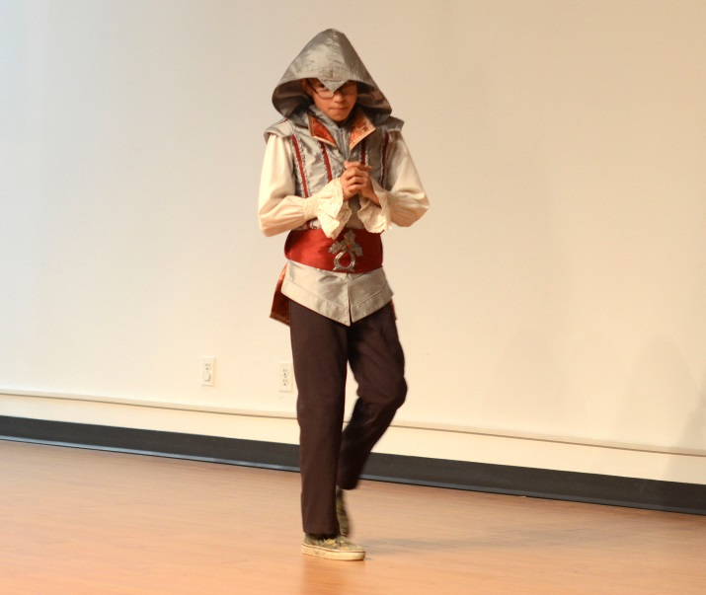
Pictures
Notes:
On this slide you can see one of our guests – Ross May – at the top there with his comic books. He is the one I found in the newspaper.
Also on the left there is one of our panelists talking about Steampunk.
And then at the bottom are a couple more cosplayers who entered our cosplay contest.

Slide 32
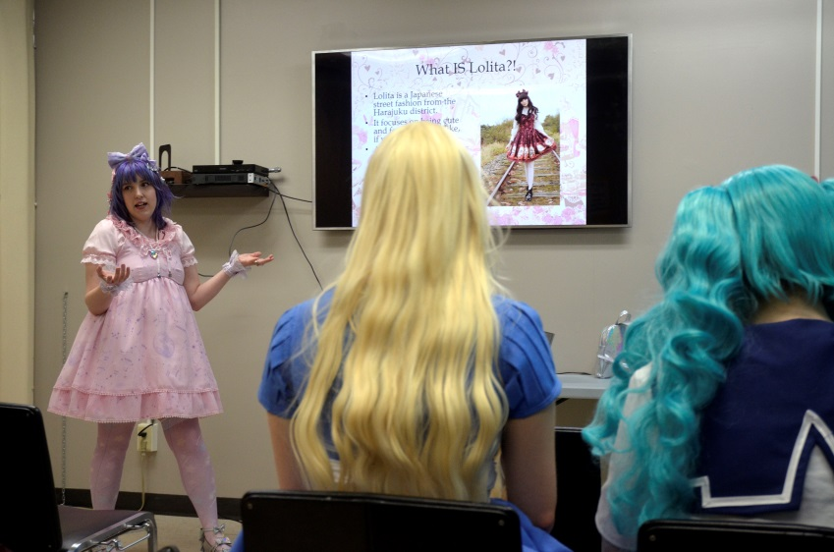
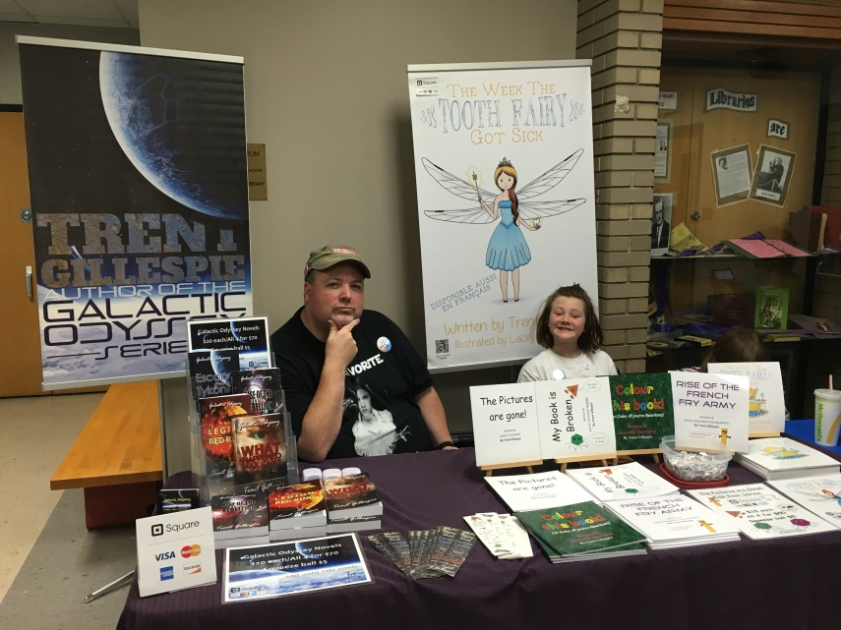
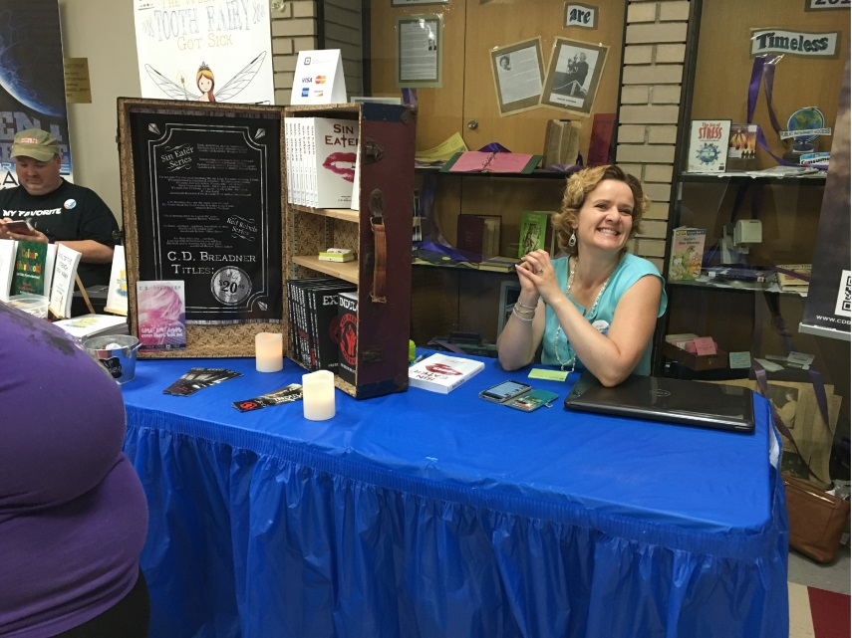
Pictures
Notes:
The top right photo there is one of me and those talented nerdy friends I mentioned.
Then the two bottom photos are a couple of the local sci-fi fantasy authors we brought in. Trent Gillespie and C.D. Breadner – Also members of the Meghan’s Talented Nerdy Friend Crew.

Slide 33
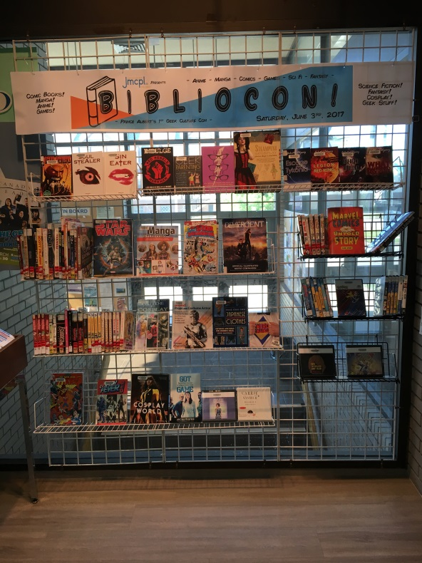
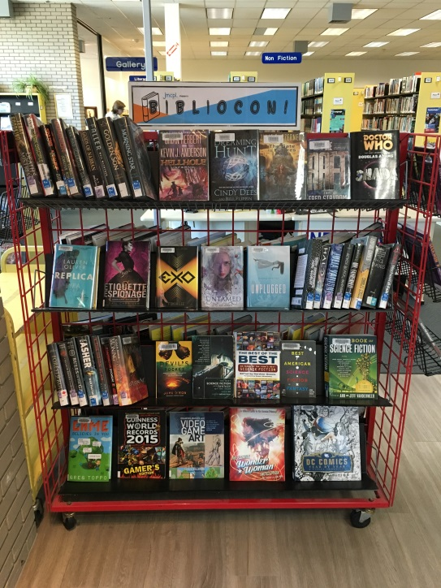
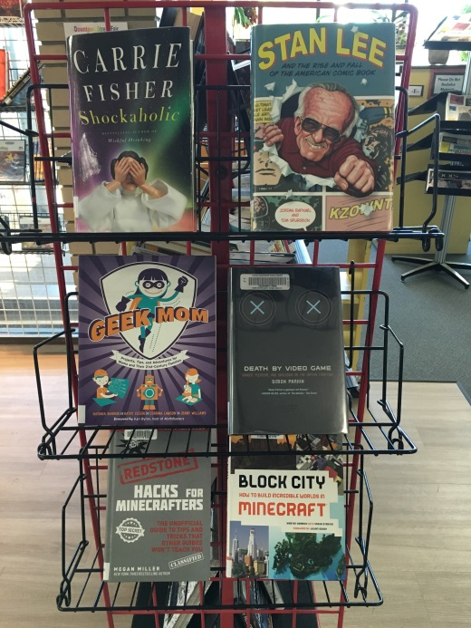
Pictures
Notes:
This slide has some pictures of the displays I set up for the day.
I was pretty proud of the displays, I have to say. We kept them up for about a month after Bibliocon was over.

Slide 34
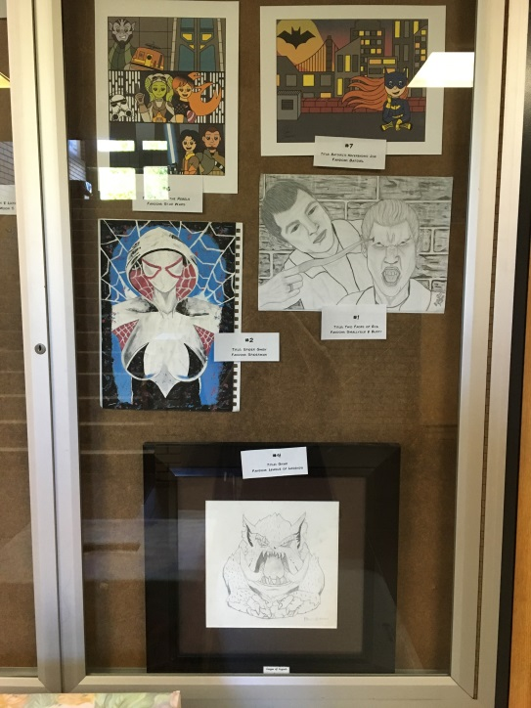
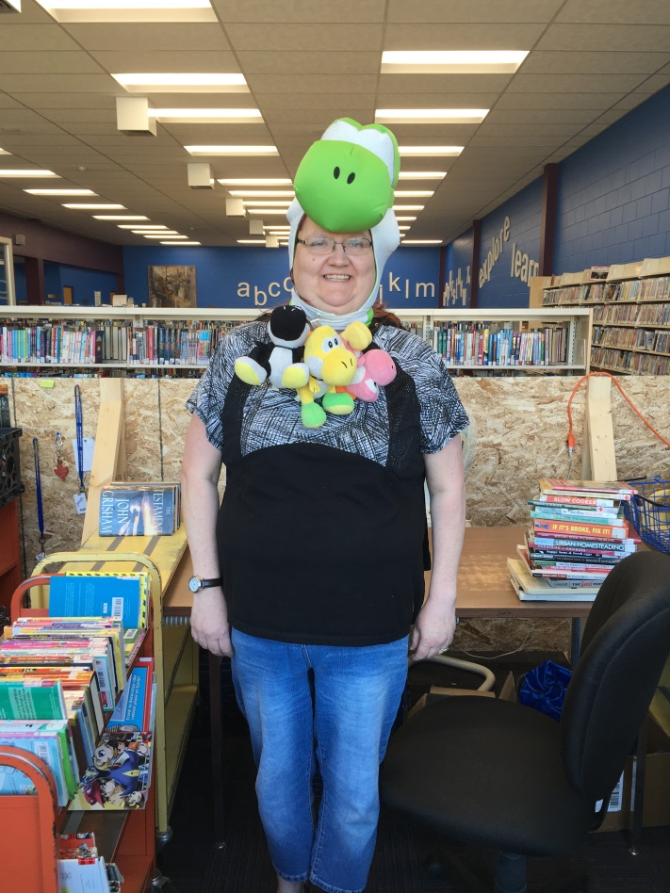
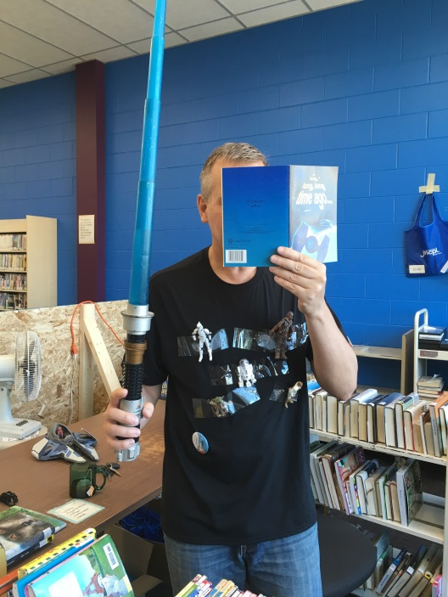
Pictures
Notes:
And here we have a couple pictures of the fan art contest display
And a couple pictures of the staff who got in on the spirit of things and dressed in their nerdiest attire!

Slide 35
Statistics
On the day of Bibliocon we had:
19 brand new patron registrations
7 updated/renewed accounts
1207 on the gate counter (460 more than an average Saturday)
Gave away 50 of the mini Bibliocon buttons
Approx. 60-80 people attended the event
Circulation Statistics:
Graphic Novels circs did not increase
Video Game circs increased slightly
Notes:
Remember the last time I talked about statistics? Here are the statistical results of our event.
Our foot traffic increased by 460 more gate counts than an average Saturday with a program scheduled.
Probably would have been more if we could have used more of the upstairs space.
We encouraged attendees to show their library card at the circulation desk in order to get their mini Bibliocon button and if they didn’t have one we signed them up for one.
As a result we had 19 new patron registrations on that day. On average I would say we only get 3 to 4 new patron registrations a day so to get 19 in one day was pretty exciting.
We gave out 50 of the mini buttons, and I would estimate that we had around 60-80 people actually attend.
I was really pleased with the turn out. I planned for a lot of people to attend, but didn’t actually think we would have that many people show up!
As far as circulation stats for the highlighted collections go… Well, I was a little disappointed. Our graphic novel circulation didn’t increase at all, but our video game circs did by a little. Nothing to write home about.
I feel that the reason this was is because attendees weren’t upstairs much and that’s where my beautiful book displays were.
If we were able to utilize our upstairs space during the event I feel our circ stats would have been a lot better because people would have been more exposed to the material.

Slide 36
Feedback Survey
When should we host the next Bibliocon:
Most people suggested October
Online pre-registration option:
50% said it didn’t matter because the event is free
41.7% said yes, they would like online pre-register
8.3% said no.
Favourite event:
Cosplay Contest
How we can improve the next Bibliocon:
More vendors
More space
Different movies or anime episodes showings
More signage and advertisement
Some kind of food option
Notes:
After the event was over I created a feedback survey and shared it on social media and on our website.
On the survey I asked basic questions such as which panel they enjoyed the most, what could be improved upon for next time and whether people wanted a pre registration option.
Most people suggested October for next time because it was close to halloween and that would encourage more people to dress up.
For the pre-registration question most people didn’t care, but a lot said they would like a pre-register option.
Having a pre-register would give us an idea of how much schwag to order and generally give us an idea of what to expect attendance wise.
As for their favourite panels – most people said the cosplay contest was their favourite, but the Studio Ghibli film screenings were a close second favourite.
We took what people said from the “how can we improve next time” question and made a list of things we would do differently next time.

Slide 37
What we would do differently next time?
Find a food vendor
Food truck or ask a local charity group to do a BBQ outside
Change the date to October so we don’t conflict with summer holidays and other events.
Ask for more staff and volunteers
We only had two planners and I poached circ staff to help on the day of the event
Talk to the media beforehand so they can promote the event
Add more signage outside the library
Budget for some more goodies to give away
Lanyards, bracelets, badges, etc.
Use more of our space
Find more vendors
Notes:
First thing we would do is find some kind of food vendor.
We did try to find one for this event but all the food trucks and charity groups were already booked for that day. We’ll have to book earlier next time.
As for the date, we would host the next Bibliocon in the fall, probably October, or possibly late September. That way we won’t conflict with other conventions, but we won’t have to work around graduations, summer holidays, and other events around the city.
Next time I will ask for more help. There were only two of us planning the event and most of the planning fell to me, actually. On the actual day of the event I stole circ staff to help out with supervision and crowd control.
Like I mentioned before, the local newspaper sent someone out to do an article about the event, but next time I would like to talk to the newspaper ahead of time so they can advertise for us.
Also we would submit the event to StreetBeats so it gets announced on the radio.
People mentioned in the feedback survey that they would have liked more signage at the library about the event. Some said they weren’t sure if they had the correct date because there were no signs outside the library indicating the event was happening.
We didn’t have any signs made because we had a zero dollar budget, but we could spring to have some signs and banners made next time.
If possible next time I would like to toss a bit of money into getting some cool schwag to give away to attendees. The buttons were cool and people really liked them, but some lanyards or badges would be neat as well.
I would also like to use more of our available space next time now that our renovations are over.
And finally I would like to add more vendors since we will have a bigger space to actually set up tables.
People like to spend money at these kind of events.
Also, if you charge a small fee for vendor tables, other than the ones you give to your sponsors, you can make back a little bit of what you spend on the event.

Slide 38
Summary
Overall we were successful!
Got a lot of new people into the library!
We had fun!
We learned a lot!
People want more Bibliocon!
Notes:
We had a few goals in mind when we set out to organize a comic con at the library, and I think for the most part we met those goals.
We wanted to reach new audiences and I believe we were successful, based on our new patron registration stats from that day, in getting new people into the library to experience something fun and interesting.
Circulation stats on the highlighted collections weren’t quite as successful as I hoped, due to circumstances, but again I feel that next time will be better.
Overall, the event was fun to plan and host.
And, we learned a lot about how to host an event like this and we know how to make it better for next time.
Planning for the next Bibliocon is tentative right now as it has been a busy year for us lately, but we’ve had patrons asking about it so we’re hoping to have another Bilbiocon this fall if we can get the planning group set up.

Slide 39
Questions?
My email:
moleary@jmcpl.ca
Website:
http://www.jmcpl.ca/bibliocon
Hoopla has a webinar available for people wanting to host a comic con at the library:
https://vimeo.com/297778827
Notes:
Well that’s it, that’s all folks!
Thank you for coming to my presentation about Bibliocon.
If you would like to check out our Bibliocon webpage I’ve provided the link here.
If you would like to plan your own comic con Hoopla has a great webinar available that can be found at the link on the screen.
And I’ve included my email address in case anyone thinks of a question to ask later. Feel free to send me an email!
Does anyone have any questions?

